Slide 1
IMPLEMENTATION of SHANON FANO CODING
Partha Pritam Paul(14-1-5-059)
Udit Narayan Bora(14-1-5-062)
Under the guidance of
Mr. Umakant Majhi
Dept. of Computer Science and Engineering

Slide 2
INTRODUCTION
In today's world of digitalization, all the data which is to be processed or transmitted or received should contain as minimum memory or bits as possible. So to reduce the bits or to compress the data, there are several techniques, one of these techniques is known as Shannon-Fano algorithm, named after Claude Shannon and Robert Fano.
It is a technique for constructing a “prefix code” based on a set of symbols and their probabilities (estimated or measured). It guarantees that all codeword lengths are within one bit of their theoretical ideal.

Slide 3
The algorithm produces fairly efficient variable-length encodings, when the two smaller sets produced by a partitioning are in fact of equal probability and the one bit of information used to distinguish them is used most efficiently.
Shannon–Fano coding is used in the IMPLODE compression method, which is part of the ZIP file format, where it is desired to apply a simple algorithm with high performance and minimum requirements for programming.

Slide 4
SHANON-FANO ALGORITHM
A Shannon-Fano tree is built according to a specification, designed to define an effective code table. The actual algorithm is simple. For a given list of symbols, develop a corresponding list of probabilities or frequency counts so that each symbol’s relative frequency of occurrence is known.
Shannon-Fano source encoding follows the steps:
1. Order symbols mi in descending order of probability
2. Divide symbols into subgroups such that the subgroup’s probabilities (i.e. Information contests) are as close as possible.
3. Allocating codeword’s: assign bit 0 to top subgroup and bit 1 to bottom subgroup.
4. This means that the codes for the symbols, in the first part will all start with 0, and the codes in the second part will all start with 1.

Slide 5
5. Iterate steps 2 and 3 as long as there is more than one symbol in any subgroup, subdividing groups and adding bits to the codes until each symbol has become a corresponding code leaf on the tree.
6. Extract variable-length codeword’s from the resulting tree (top- down). Codeword’s must follow Prefix condition i.e. no codeword forms a prefix for any other codeword, so they can be decoded unambiguously.

Slide 6
SHANON-FANO CODING EXAMPLE
Example for 8 symbols:-
Solution:-
Symbol | A | B | C | D | E | F | G | H
Probability | 0.20 | 0.27 | 0.06 | 0.16 | 0.17 | 0.04 | 0.04 | 0.06
Symbol | Probability | Step 1 | Step 2 | Step 3 | Step 4 | Codeword
A | 0.27 | 0 | 0 |  |  | 00
B | 0.20 | 0 | 1 |  |  | 01
C | 0.17 | 1 | 0 | 0 |  | 100
D | 0.16 | 1 | 0 | 1 |  | 101
E | 0.06 | 1 | 1 | 0 | 0 | 1100
F | 0.06 | 1 | 1 | 0 | 1 | 1101
G | 0.04 | 1 | 1 | 1 | 0 | 1110
H | 0.04 | 1 | 1 | 1 | 1 | 1111

Slide 7
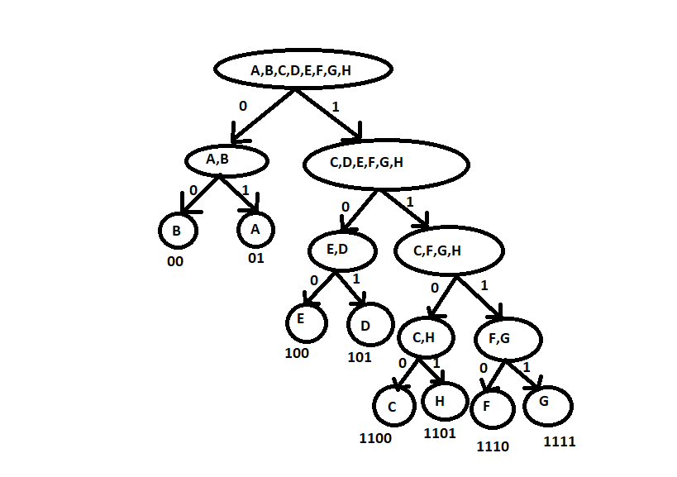
SHANON-FANO TREE

Slide 8
IMPLEMENTATION USING C
Definition of structure:
struct node
{
char sym[10];
float pro;
int s[20];
}s[20];
typedef struct node node;
Main function:
printf(“enter the no. of symbols:");
scanf("%d", &n);
for(i=0;i<n; i++){
printf("Enter symbol %d ---> ",i+1);
scanf("%s",ch);
strcpy(s[i].sym,ch);
} int total=0;
for(i=0; i<n; ++i){
printf("Enter prob. for %s ---> ",s[i].sym);
scanf("%f",&x);
s[i].pro=x;
total=total+s[i].pro;
if(total>1){
printf("This prob. is not possible.”)
total=total-s[i].pro;
i--;}}

Slide 9
IMPLEMENTATION USING C
Applying insertion sort to sort the
Symbols in decreasing order of their
Of their frequencies.
for(i=1;i<n; i++){
temp = s[i].pro;
j=i-1;
while(temp>s[j].pro && j>=0){
s[j+1].pro = s[j].pro;
--j;
}
s[j+1].pro = temp;
}
Taking an n*n matrix “code” and make all elements “X”
char code[20][20];
for(i=0; i<n; ++i)
{
for(j=0;j<n;j++)
{
code[i][j] = 'X';
}
}
Function calling:
shannon(0,n-1,s,code,0);

Slide 10
IMPLEMENTATION USING C
Shannon function:
void shannon(int start,int end, node s[], char code[20][20],int level)
{
//declaration
int i=start;
int j=end;
float isum = s[i].pro,jsum = s[j].pro;
int g_level = 0;
//increment of g_level
if(level>g_level)
{
g_level = level;
}
//Making Partition
while(i<(j-1))
{
while(isum>jsum && i<(j-1))
{
j--;
jsum += s[j].pro;
}
while(isum<jsum && i<(j-1))
{
i++;
isum += s[i].pro;
}
}

Slide 11
IMPLEMENTATION USING C
//Filling the “code(n*n)” matrix,
Considering each iteration as level
if(i==start) {
code[start][level]='0';
}
else if((i-start)>=1){
int k;
for(k=start;k<=i;++k)
code[k][level] = '0';
shannon(start,i,s,code,level+1);
}
if(j==end)
{
code[end][level]='1';
}
else if((end-j)>=1)
{
int k;
for(k=j;k<=end;++k)
code[k][level] = '1';
shannon(j,end,s,code,level+1);
}
}

Slide 12
IMPLEMENTATION USING C
Printing output (in Main()):
printf("---------------------------------------------------------------");
printf("\nSymbol\tProbability\tCode\n");
for(i=0; i<n; ++i) {
printf("%S\t %f\t :", s[i].sym,s[i].pro);
for(j=0; j<=g_level; j++)
{
if(code[i][j]!='X')
printf("%c",code[i][j]);
}
printf("\n");
}
printf("\n---------------------------------------------------------------");
printf("\n\n");
return 0;

Slide 13
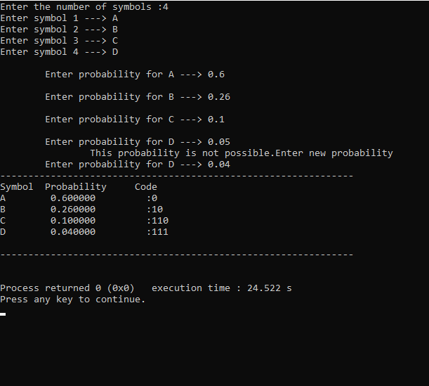
SNAPSHOT OF THE OUTPUT

Slide 14
CONCLUSION
So through the project we have successfully concluded that although the algorithm guarantees that all codeword lengths are within one bit of their theoretical ideal but the algorithm is suboptimal.
By suboptimal we mean that it doesn’t achieve the lowest possible expected codeword length like other coding schemes.

Slide 15
REFERENCES
1. Wikipedia
2. SlideShare
3. “Elements of Information Theory”
by Thomas M Cover and Joy A Thomas.

